Slide 1
Embedded System
(Sistem tertanam)
Pertemuan II :
Pendahuluan
Oleh: M. Priyono Tri Sulistyanto, S.T., M.Eng

Slide 2
Materi Kuliah
Kontrak Kuliah
Pendahuluan
Arduino
Embedded Debugging
ATmega328P
GPIO (General Purpose Input/Output)
Time Ports
Interrupt Processing
Serial Communication
Non-Volatile Memory
Example Project 1
Example Project 2
Example Project 3
Example Project 4
Embedded System (Teknik Informatika)
2

Slide 3
Embedded System?
An embedded system is a computer system with a dedicated function within a larger mechanical or electrical system, often with real-time computing constraints.
Embedded System (sistem tertanam) adalah sistem komputer dengan fungsi yang khusus didalamnya terdapat sistem elektonik atau mekanik yang besar, seringkali dengan batasan berupa komputasi real time
Embedded System (Teknik Informatika)
3

Slide 4
Karakteristik Embedded System
Menjadi bagian dari sistem yang lebih besar
Application-specific, bahkan sebagian bekerja dengan real-time.
Baik hardware maupun software dirancang khusus untuk aplikasi yang spesifik.)
Interaksi dengan dunia fisik
Embedded System (Teknik Informatika)
4

Slide 5
Embedded System
Biaya (cost) -> cost effective hardware
Constraint waktu -> mostly real-time application
Interaksi langsung dengan dunia nyata
Constraint energi -> low power
Elektronika
Embedded System (Teknik Informatika)
5

Slide 6
Embedded System v.s Dekstop Computer
Embedded | Desktop
Fungsi khusus | Fungsi umum
Banyak pilihan prosesor (dari 8 bit sampai 64 bit) | Pilihan prosesor terbatas (Pentium, AMD, PowerPC dsb)
Cost sensitive (harus murah) | Sedikit Mahal
Real time
Operating System umumnya real-time OS / RTOS | Operating System umumnya tidak harus real-time OS : Unix, windows
Kegagalan sistem umumnya berakibat serius | Kegagalan tidak berakibat fatal
Embedded System (Teknik Informatika)
6

Slide 7
Embedded System v.s Dekstop Computer
Embedded | Desktop
Daya terbatas (batere, solar cell) | Daya dari jala-jala
Sering dioperasikan pada tempat yang alamnya kurang bersahabat: Luar angkasa , Tengah laut, Tempat dingin/panas | Sering dioperasikan di tempat yang alamnya bersahabat
Sumber daya terbatas : RAM, ROM, CPU | Sumber daya banyak: RAM besar ,ROM besar, CPU cepat
Program disimpan di ROM | Program disimpan di hard disk / magnetic media
Embedded System (Teknik Informatika)
7

Slide 8
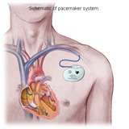
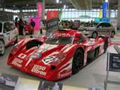
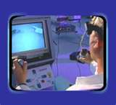

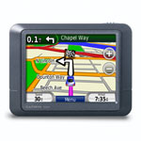

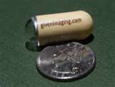


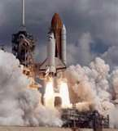
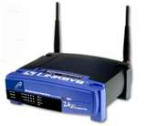
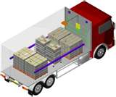

Embedded System in every where
Embedded System (Teknik Informatika)
8

Slide 9
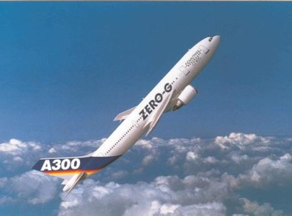
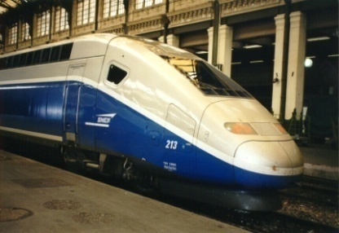

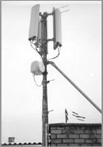
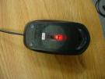
Embedded System in every where
Kendali proses:
Food processing (pabrik)
Chemical plants (pabrik)
Otomotif
Engine control
Antilock braking system
Pesawat Terbang
Kereta Api
Telekomunikasi
Office Automation
FAX machine
Copiers
Computer Peripherals
Printer
Terminal
Disk drive
Modem
Scanner
Mouse (optical)
Embedded System (Teknik Informatika)
9

Slide 10
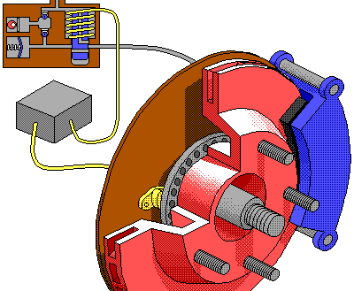
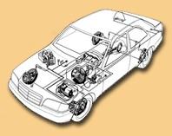
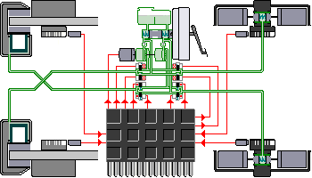
Embedded System in every where
Embedded System (Teknik Informatika)
10

Slide 11
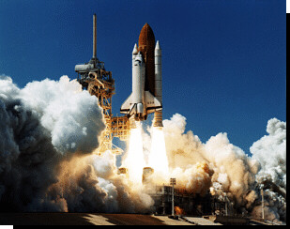
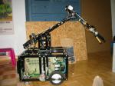
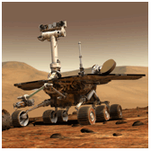
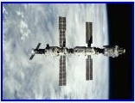
Embedded System in every where
Communication
Switches
Routers
Robot
Aerospace
Flight management System
Weapons Systems
Jet engine controls
Domestic
Microwave oven
Dishwashers
Washing machines
thermostats
Embedded System (Teknik Informatika)
11

Slide 12
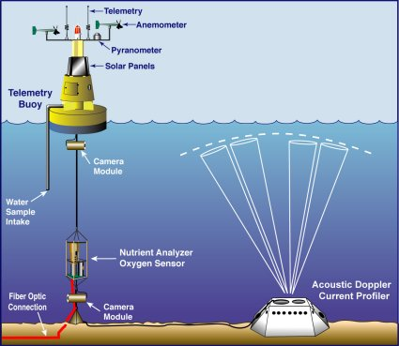
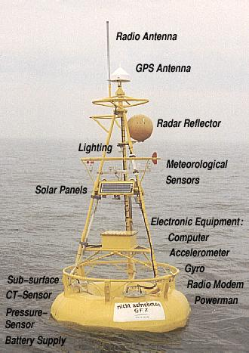
Embedded System in every where
Buoy di laut dengan sensor lingkungan
Embedded System (Teknik Informatika)
12

Slide 13
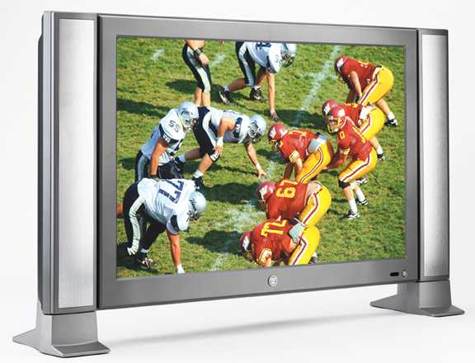

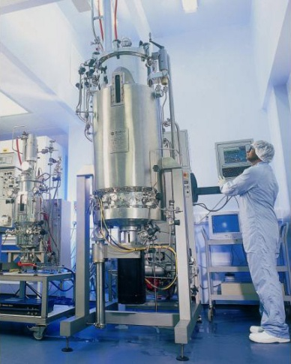
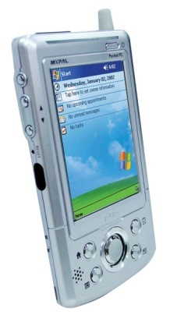
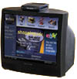

Embedded System in every where
Consumer Electronic
Pabrik (proses kimia)
Embedded System (Teknik Informatika)
13

Slide 14
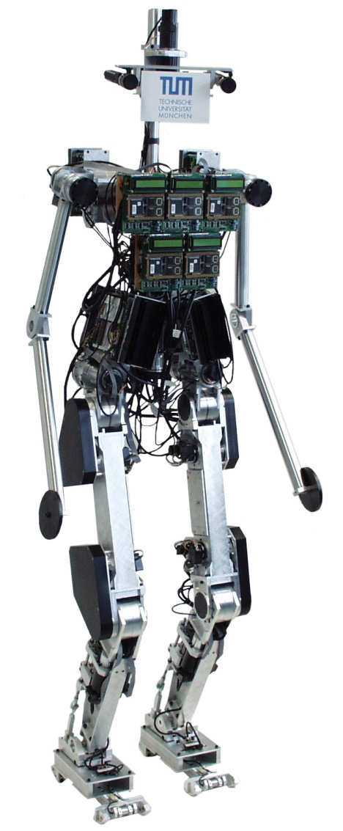
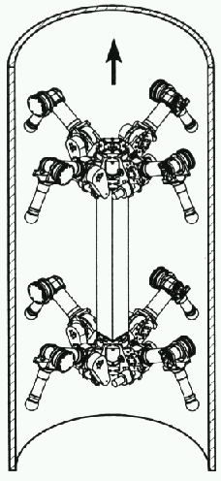
Embedded System in every where
Robot
Embedded System (Teknik Informatika)
14

Slide 15
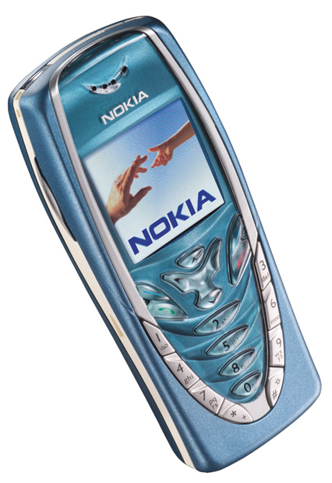
Embedded System in every where
Telepon bergerak
Multiprocessor
8-bit/32-bit for UI
DSP for signals
32-bit in IR port
32-bit in Bluetooth
8-100 MB of memory
All custom chips
Power consumption & battery life depends on software
Embedded System (Teknik Informatika)
15

Slide 16
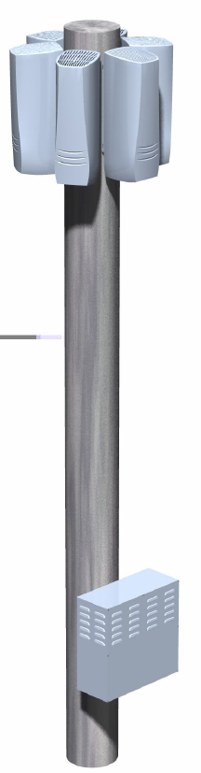
Embedded System in every where
Massive signal processing
Several processing tasks per connected mobile phone
Based on DSPs
Standard or custom
100s of processors
Embedded System (Teknik Informatika)
16

Slide 17
Embedded System in every where
Massive signal processing
Several processing tasks per connected mobile phone
Based on DSPs
Standard or custom
100s of processors
Embedded System (Teknik Informatika)
17

